Slide 1
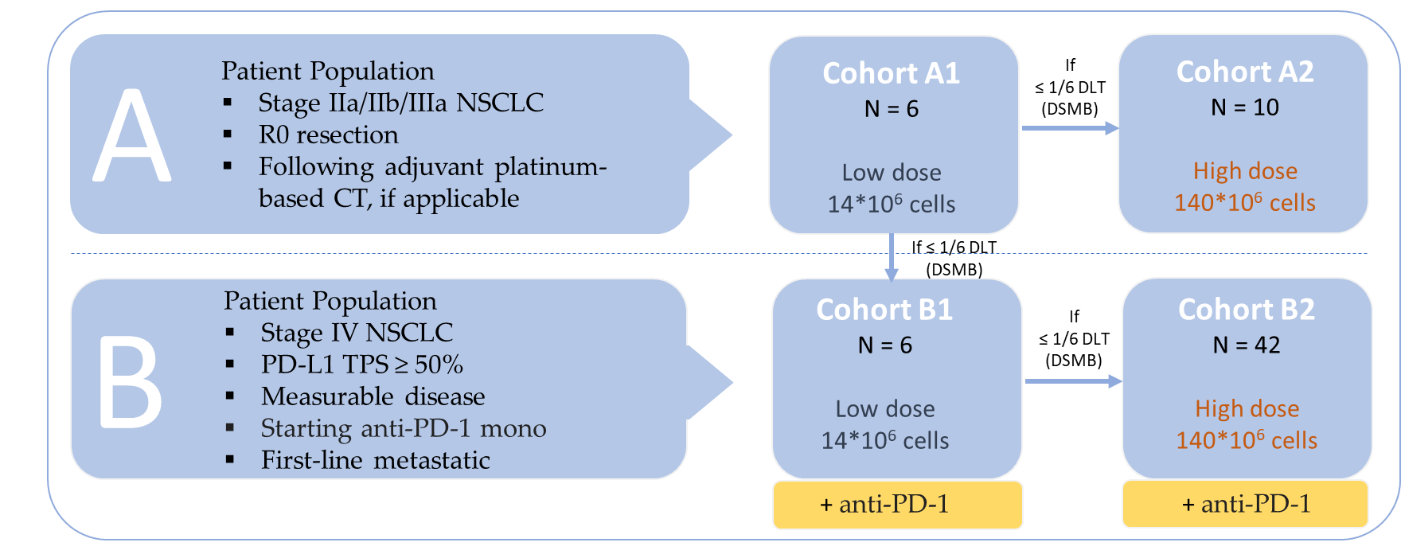
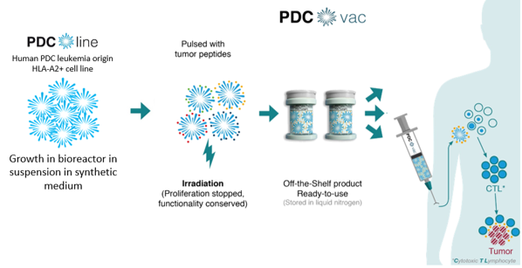
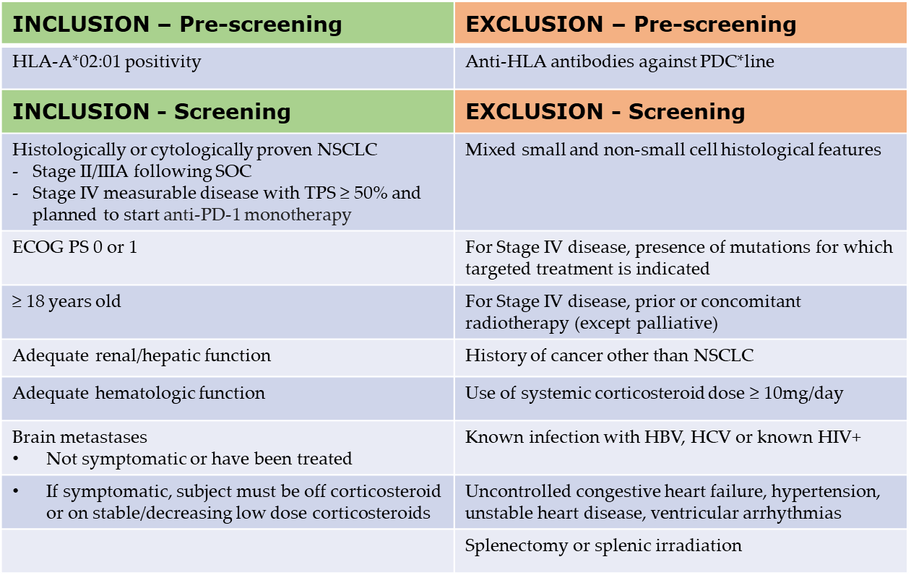
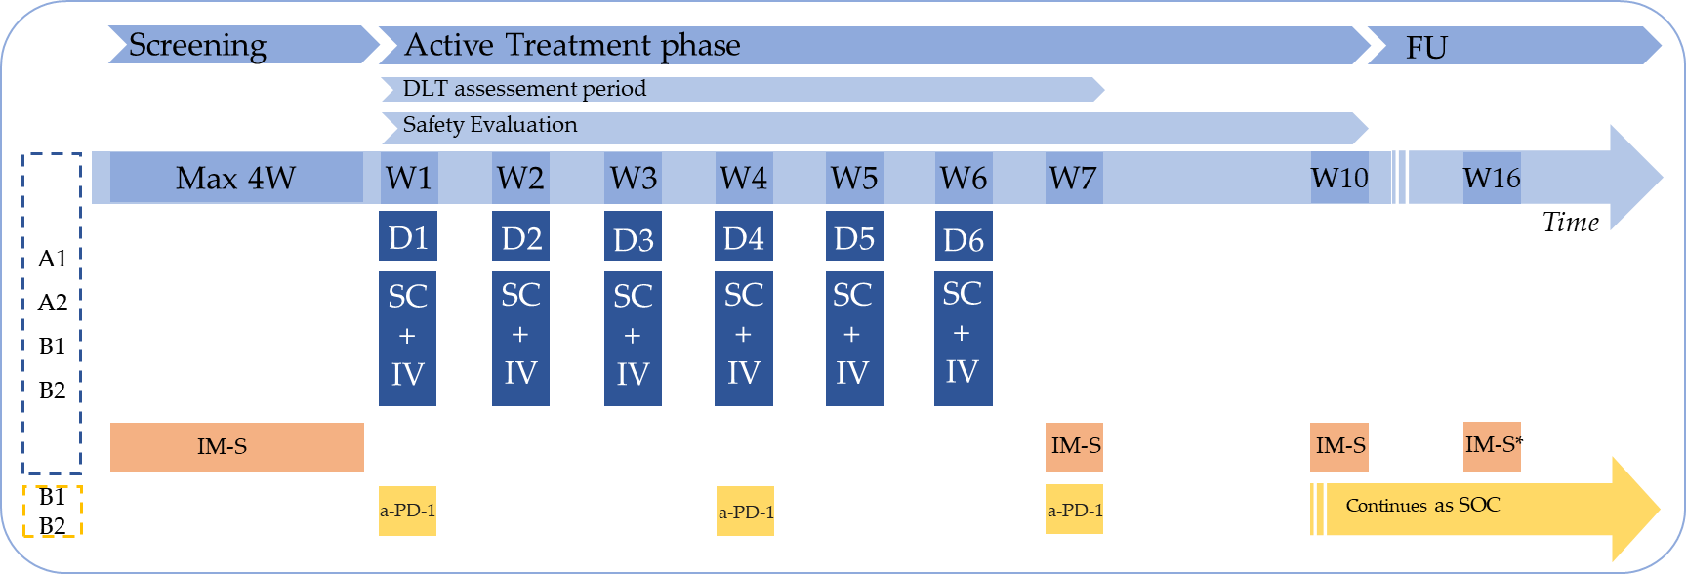
Abstract #323: An open-label, dose escalation, Phase I/II study to assess safety, tolerability, immunogenicity and preliminary clinical activity of the therapeutic cancer vaccine PDC*lung01 with or without anti-Programmed Death-1 (PD-1) treatment in patients with Non-small cell lung cancer (NSCLC)
J. Bennouna¹, A. Sibille², C. Debruyne³, B. Colinet⁴, I. Demedts⁵, S. Derijcke⁶, L. Greillier⁷, J. Jurgens⁸, H. Lena⁹, D. Moro-Sibilot¹⁰, M. Pérol¹¹, X. Quantin¹², N. Reinmuth¹³, M. Sebastian¹⁴, M. Genin³, J. Plumas³, J. Vansteenkiste¹⁵
1. Thoracic Oncology, University Hospital of Nantes, Nantes, France; 2. Department of Pulmonology, University Hospital of Liège, Liège, Belgium; 3. PDC*line Pharma SAS, France; 4. Pneumology and oncology unit, Grand Hôpital de Charleroi (GHdC), Charleroi, Belgium; 5. Department of Pulmonary Diseases, AZ Delta Roeselare, Belgium; 6. Department of Thoracic Oncology/Pulmonology, AZ Groeninge Kortrijk, Belgium; 7. Aix Marseille Univ, APHM, Marseille, France; 8. Kliniken der Stadt Koeln gGmbH, Lungenklinik Koeln- Merheim, Germany; 9. Service de Pneumologie Centre Hospitalier Universitaire Hopital Pontchaillou, Rennes, France; 10. Thoracic Oncology unit, SHUPP, CHU Grenoble Alpes, France; 11. Department of Medical Oncology, Léon Bérard Cancer Centre, Lyon, France; 12. Oncologic department; Montpellier cancer institute; Montpellier; France; 13. Thorakale Onkologie, Asklepios Fachkliniken München-Gauting, Germany; 14. Dept. of Medicine, Hematology & Oncology, University hospital Frankfurt, Germany; 15. Respiratory Oncology, University Hospitals KU Leuven, Belgium
Background and Rationale
Study Design
Study Objectives
Anti-PD-1 antibodies are the cornerstone of treatment for advanced NSCLC. However, a substantial number of patients do not benefit from PD-1 blockade when used in monotherapy
Boosting antitumor cytotoxic CD8+ T cells represents a promising approach to potentiate their efficacy
PDC*lung01 is a therapeutic cancer vaccine consisting in a plasmacytoid dendritic cell line (PDC*line), loaded with HLA-A*02:01 restricted peptides, and irradiated (PDC*vac)
Among the selected peptides, 6 are encoded by antigens expressed in NSCLC: NY-ESO-1, MAGE-A3, MAGE-A4, Multi-MAGE-A, MUC1, Survivin, and the 7th Melan-A is used as a positive control of PDC*lung01-induced immunogenicity
PDC*line is a professional antigen presenting cell able to prime and expand peptide-specific CD8+ T cells in vitro and in vivo, and is synergistic with anti-PD-1 antibodies
Open-label, multicentre, dose-escalation, phase I/II study with PDC*lung01 administered by subcutaneous and intravenous route weekly for 6 consecutive doses
Two dose levels: 14*106 cells (Low Dose) and 140*106 cells (High Dose), split equally in the 2 administration routes
Primary: Safety and tolerability of PDC*lung01 at 2 dose levels as single agent or as add-on to anti-PD-1 therapy
Secondary
Evaluation of additional safety/tolerability indicators
Evaluation of humoral allogeneic immune response against PDC*line cells
Ex-vivo evaluation of specific T-cell response against antigens borne by PDC*lung01
Document preliminary clinical activity in the B2 cohort
Statistical Design
Descriptive statistics of demographic data and disease-related characteristics will be provided
Dose Limiting Toxicity, safety and immune responses will be analysed for each individual cohort and for cohorts A1+A2 and B1+B2 jointly
For Stage IV population receiving high dose PDC*lung01 added to anti-PD-1
Secondary endpoint is 9 months progression-free survival (PFS) and Objective response rate (ORR) per Response Evaluation Criteria in Solid Tumours version 1.1 (RECIST 1.1) as well by iRECIST
Sargent 2-stage design
Primary data cut-off is when 42 evaluable patients have reached 9 months since first dosing or have discontinued earlier
An interim analysis for futility will be performed in the first 19 evaluable patients
Time-to-event endpoints (ie PFS, duration of response) will be reported using Kaplan-Meier estimates
Figure 1: Principle of PDC*vac, an off-the-shelf cell-based cancer vaccine
Figure 2: Cohort Study Design
Dose Limiting Toxicities: Definition
Eligibility Criteria
Treatment Schedule
All CTCAE Grade 4 and 5 toxicities
CTCAE Grade 3 toxicities
Non-haematological toxicity (not laboratory) lasting > 48 hours despite optimal treatment
Non-haematological laboratory value in case of (1) Medical intervention required, (2) Hospitalization or (3) Clinically relevant and persists > 48 hours
Cytokine Release Syndrome persisting > 48 hours despite treatment
Allergic reaction and/or anaphylaxis and/or infusion related reaction occurring within 24 hours post-injection
Study Status
Patients will be enrolled at ≈ 20 sites from Belgium, France, Germany, The Netherlands and Poland
Enrolment started in February 2020
Enrolment first cohort is completed; other cohorts are ongoing
Study Information
Protocol Number: PDC-LUNG-101
Clinical Trial Identification: NCT03970746
Acknowledgements: This study is sponsored by PDC*line Pharma SAS.
Disclosure Statement: There are no conflicts of interest to declare by Prof. Dr. J. Bennouna
Contact info: c.debruyne@pdc-line-pharma.com
Figure 3: Treatment Schedule | W = Week, D = Dose, SC = Subcutaneous, IV = Intravenous, FU = Follow-Up, IM-S = Immuno monitoring sampling. *Not applicable in the B2 cohort
Table 1: Pre-screening & Screening Eligibility Criteria

